Slide 1
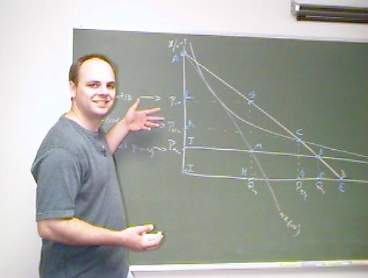

Slide 2
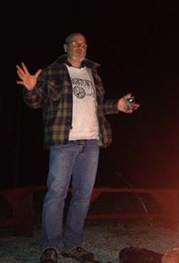
John 1.1: Ἐν ἀρχῇ ἦν ὁ λόγος:
In the beginning was the Word…
revelation of God
to Jews
eternal reason
to Greeks
You might ask, which word? Was it “pizza”?

Slide 3
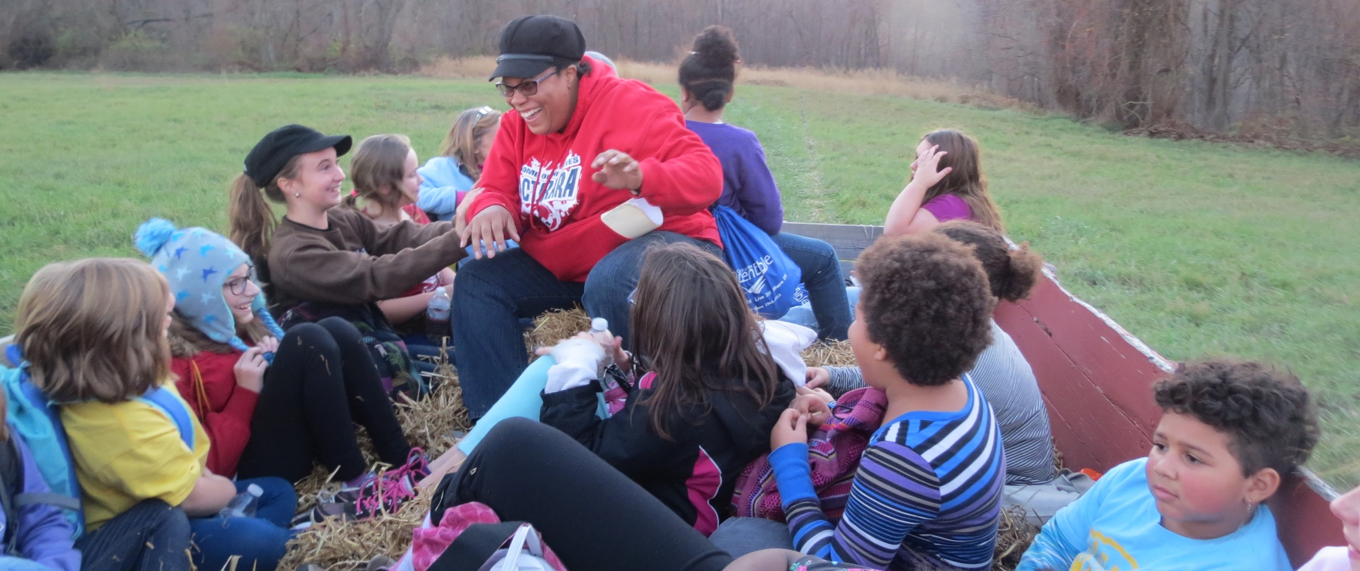
Teach = empower and motivate for learning
Cognitive: share information, help process it
Affective: help care about it, motivate, encourage
Behavioral: show what to do with it

Slide 4
Ephesians 4.11-15 NET: It was he who gave some as apostles, some as prophets, some as evangelists, and some as pastors and teachers, to equip the saints for the work of ministry, that is, to build up the body of Christ, until we all attain to the unity of the faith and of the knowledge of the Son of God– a mature person, attaining to the measure of Christ's full stature. So we are no longer to be children, tossed back and forth by waves and carried about by every wind of teaching by the trickery of people who craftily carry out their deceitful schemes. But practicing the truth in love, we will in all things grow up into Christ, who is the head.

Slide 5
Ephesians 4.11-15 NET: It was he who gave some as apostles, some as prophets, some as evangelists, and some as pastors and teachers, to equip the saints for the work of ministry, that is, to build up the body of Christ, until we all attain to the unity of the faith and of the knowledge of the Son of God– a mature person, attaining to the measure of Christ's full stature. So we are no longer to be children, tossed back and forth by waves and carried about by every wind of teaching by the trickery of people who craftily carry out their deceitful schemes. But practicing the truth in love, we will in all things grow up into Christ, who is the head.

Slide 6
Ephesians 4.11-12 NET: It was he who gave some as apostles, some as prophets, some as evangelists, and some as pastors and teachers, to equip the saints for the work of ministry, that is, to build up the
body of Christ...
saint = ἅγιος
[HA-gee-ahs]

Slide 7
Ephesians 4.11-12 NET: It was he who gave some as apostles, some as prophets, some as evangelists, and some as pastors and teachers, to equip the saints for the work of ministry, that is, to build up the
body of Christ...
saint = ἅγιος
[HA-gee-ahs]
1 Corinthians 1.2 ESV: To the church of God that is in Corinth, to those sanctified in Christ Jesus, called to be saints together with all those who in every place call upon the name of our Lord Jesus Christ, both their Lord and ours…

Slide 8
Matthew 28.19-20a NET: “Therefore go and make disciples of all nations, baptizing
them in the name of the Father
and the Son and the Holy Spirit,
teaching them to obey everything
I have commanded you.”
God
God
Family
Church
God’s image bearers
reflect his character
represent him in life
rule [steward] in his name
reproduce his image
Creation
Peoples

Slide 9
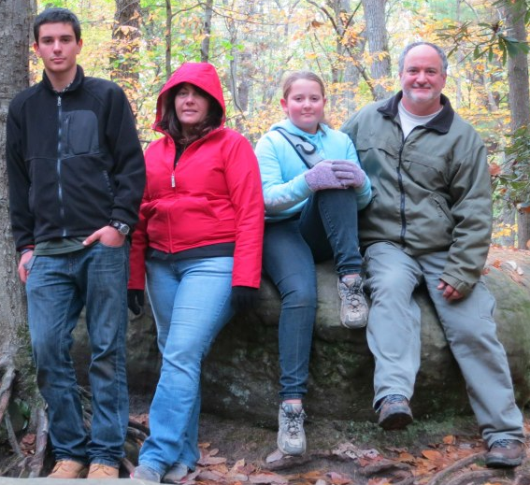
Genesis 1.27-28a NET: God created humankind in his own image, in the image of God he created them, male and female he created them. God blessed them and said to them, “Be fruitful and
multiply!
Fill the
earth and
subdue it!”
God
Family
Creation

Slide 10
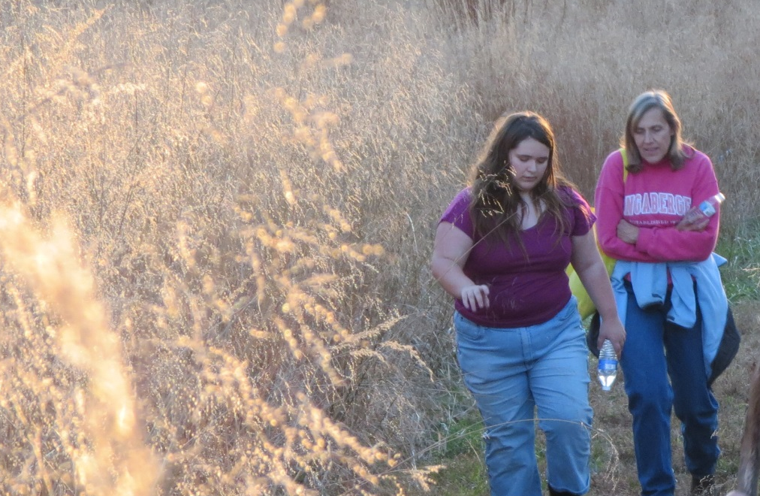
2 Timothy 2.2 NLT: You have heard me teach things that have been confirmed by many reliable
witnesses. Now teach these truths to other
trustworthy people who will be able to
pass them on to others.
God
Church
Peoples

Slide 11
Hebrews 5.11-14 NET: On this topic we have much to say and it is difficult to explain, since you have become sluggish in hearing. For though you should in fact be teachers by this time, you need someone to teach you the beginning elements of God's utterances. You have gone back to needing milk, not solid food. For everyone who lives on milk is inexperienced in the message of righteousness, because he is an infant. But solid food is for the mature, whose perceptions are trained by practice to discern both good and evil.

Slide 12
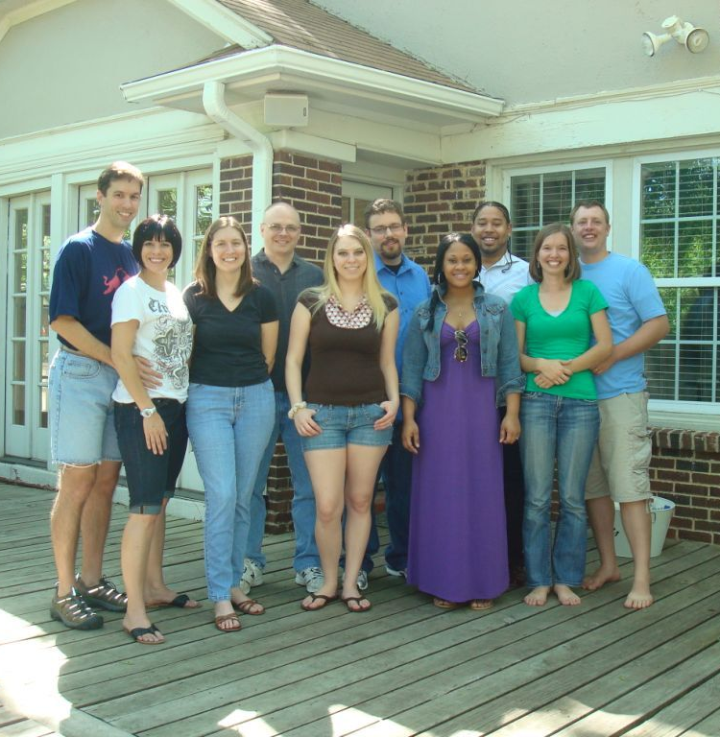
Colossians 3.16 NET: Let the word of Christ dwell in you richly, teaching and exhorting one another with all wisdom, singing
psalms, hymns, and
spiritual songs, all
with grace in your
hearts to God.

Slide 13
1 Corinthians 12.28-31a NET: And God has placed in the church first apostles, second prophets, third teachers, then miracles, gifts of healing, helps, gifts of leadership, different kinds of tongues. Not all are apostles, are they? Not all are prophets, are they?
Not all are teachers, are they? Not all perform miracles, do they? Not all have gifts of healing, do they? Not all speak in tongues, do they? Not all interpret, do they? But you should be eager for the greater gifts.

Slide 14
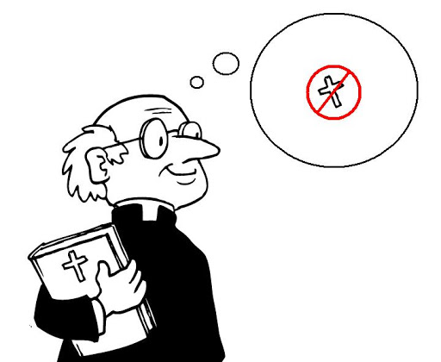
James 3.1 NET: Not many of you should become teachers, my brothers and sisters, because you know that we will be judged more strictly.
graphic from discovermagazine.com

Slide 15
Become equipped and empowered to teach!
To get ready:
sip milk and eat solid food
get help from others on the teaching team
When ready to start:
come to periodic ongoing training
work with the other teachers
accept guidance from the ministry leaders
When teaching, prepare:
pray, study, think and create, write, and practice
share God’s truth with God’s love

Slide 16
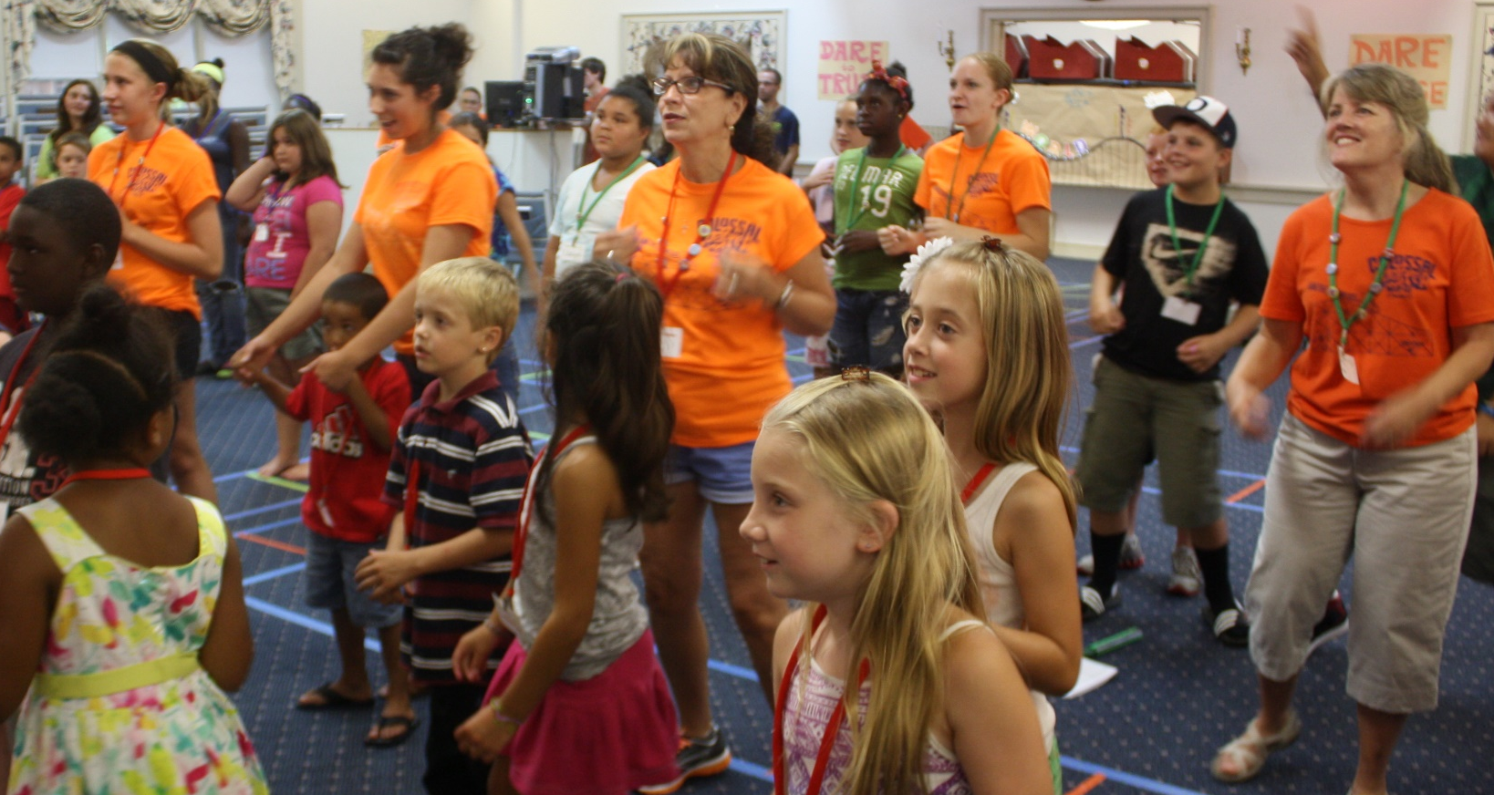
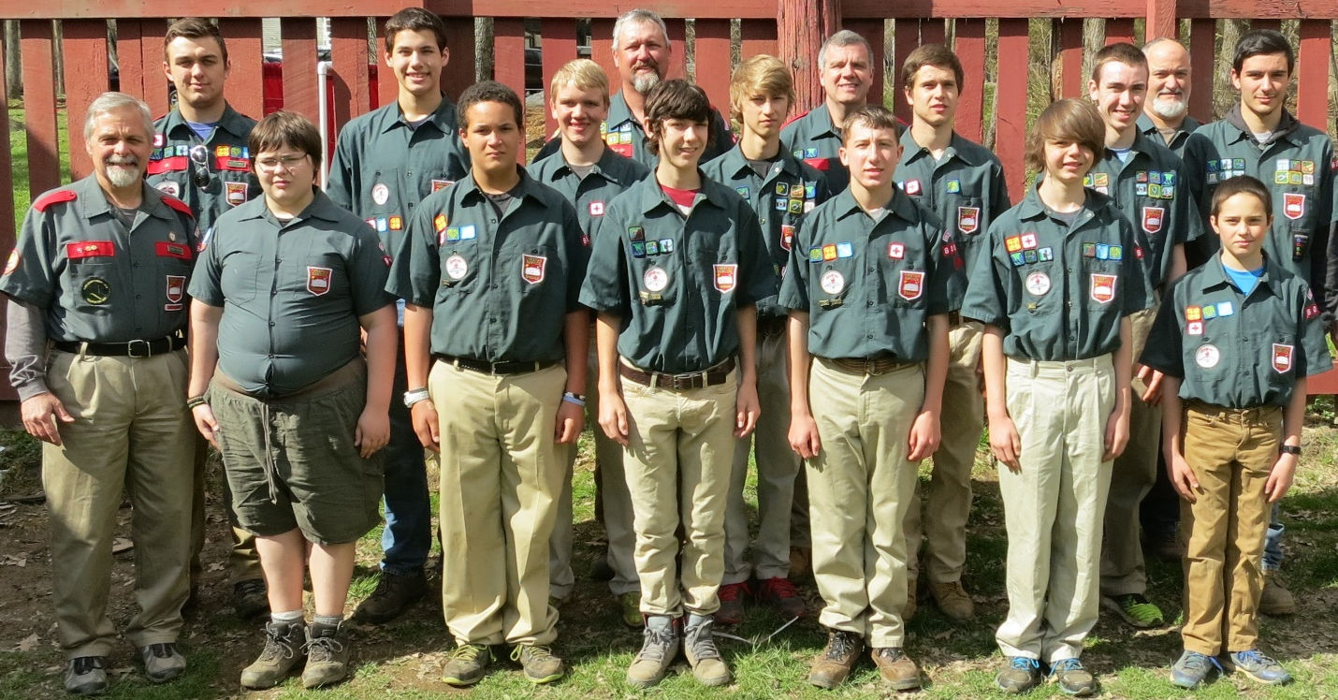
Ask God to guide you to whom you should teach!
children
teenagers
young adults
older adults
recovering addicts
elderly shut-ins
???

Slide 17

Children
curriculum researcher
Sunday morning teacher
GEMS leader
Stockade leader

Slide 18
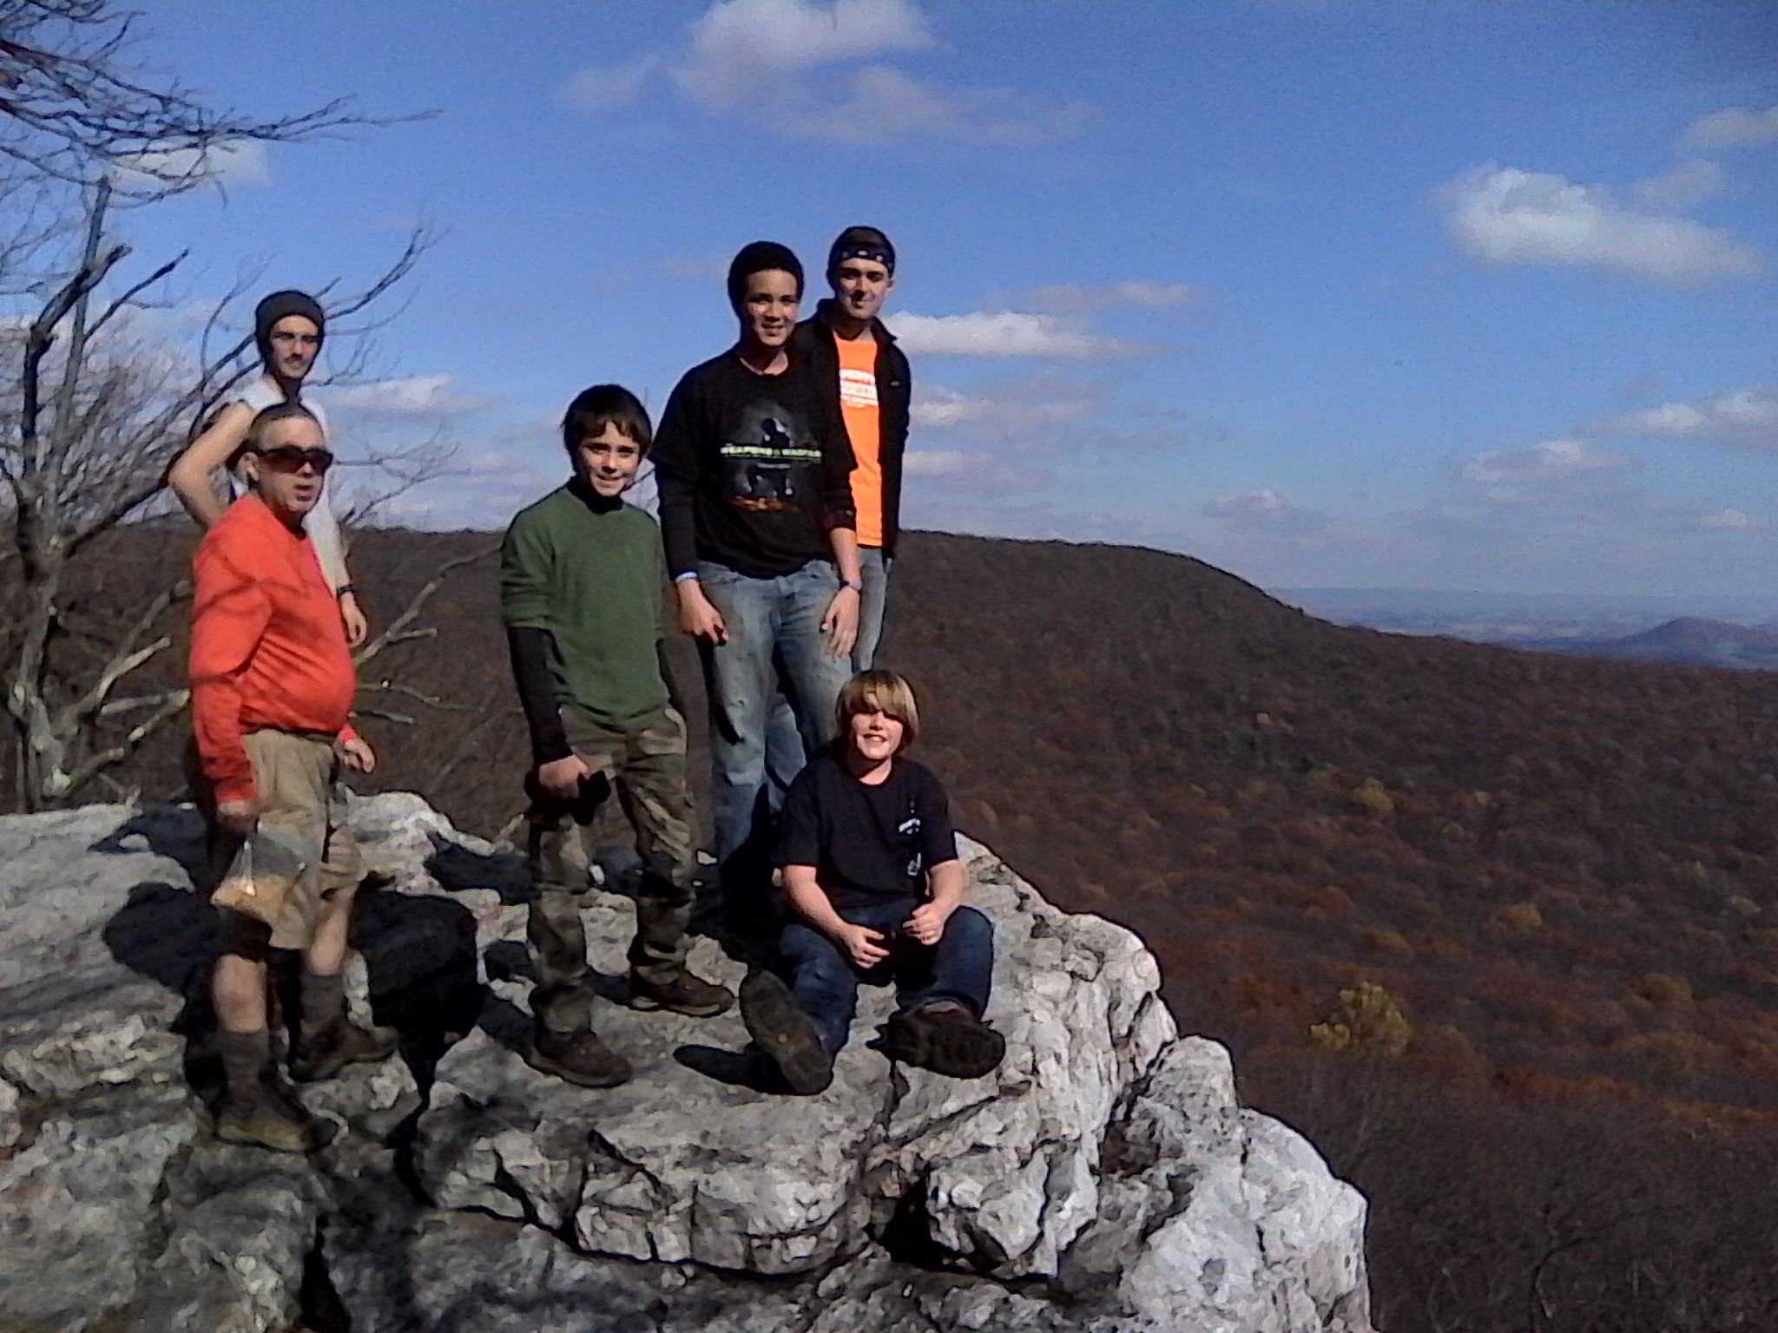
Youth
curriculum developer
Sunday school teacher
Large group coordinator
CSB Activity leader
GEMS / SG leader
CSB / SG leader

Slide 19
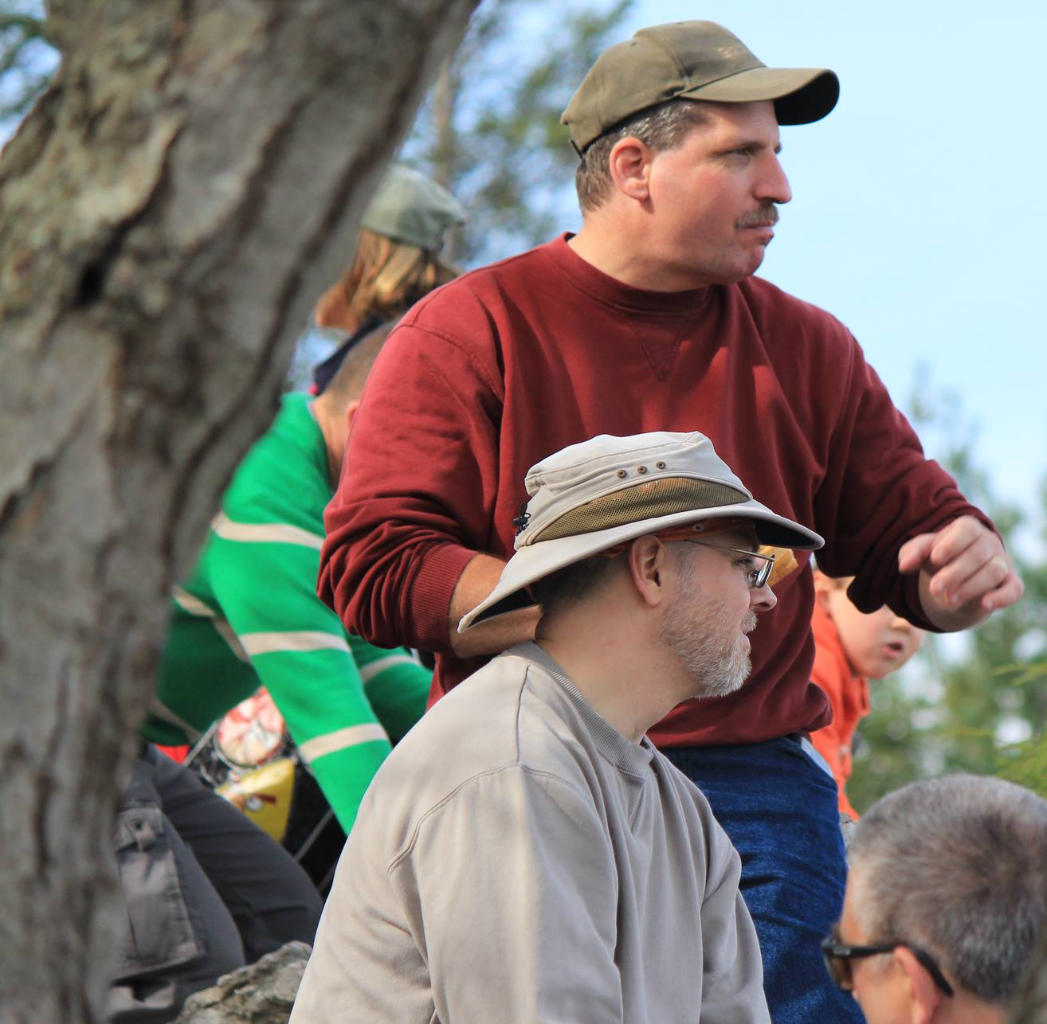
Adults
Small group leader/apprentice
Mentor
Visitation volunteer
Young Adult teacher
???

Slide 20
Children
curriculum researcher
Sunday morning teacher
GEMS leader
Stockade leader
Adults
SG leader/apprentice
Mentor
Visitation volunteer
Young Adult teacher
Youth
curriculum developer
Sunday school teacher
Large group coordinator
GEMS / SG leader
CSB / SG leader
CSB Activity leader

Slide 21
Exalt
God
Edify
One Another
Evangelize
Others
Worship
Teaching
Prayer
Quiet Time
Serving
Witness

